Slide 1
Analyzing MPI-3.0 Process-Level Shared Memory: A Case Study with Stencil Computations
Xiaomin Zhu¹, Junchao Zhang², Kazutomo Yoshii², Shigang Li³, Yunquan Zhang³, Pavan Balaji²
¹National SuperComputer Center in Jinan
²Argonne National Laboratory
³Institute of Computing Technology, Chinese Academy of Sciences
PPMM2015, Shenzhen, China

Slide 2
Outline
Introduction
Implementation
Overhead Analysis and Solutions
Communication Performance Evaluation
Conclusion and Future Work
Summary

Slide 3
Outline
Introduction
Implementation
Overhead Analysis and Solutions
Communication Performance Evaluation
Conclusion and Future Work
Summary

Slide 4
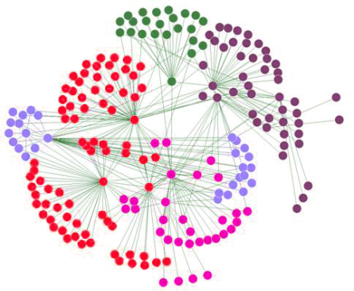

Introduction
MPI and Communication
De facto standard; installed on all supercomputers
Message Passing Interface
Communication
Big data –Data-intensive Applications
Power Consumption

Slide 5
Introduction
MPI- Distributed Memory Abstraction
Intra-node Communication
Process-level separation
Communication for intra-node processes, similar mechanism is adopted, which needs multi memory copies
This is suboptimal, as the memory is shared within the same node
Multicore even many-core technique is adopted by vendors, and the core number is increasing.
Intra-node communication plays an increasingly important role in many applications, and will contribute more to the performance

Slide 6
Introduction
Intra-node Communication
NIC loop-back
Reducing copy times
Two→One→Zero
Zero: with overhead
Hybrid MPI+thread
It requires multi-threading support from MPI, which complicates MPI implementations and often adds considerable overhead to communication.

Slide 7
Introduction
Node0
Node1
P1
P2
P3
P4
P1
P2
P3
P4
Network

Slide 8
Introduction
Node0
Node1
P1
P2
P3
P4
P1
P2
P3
P4
NIC Loop-back
Network

Slide 9
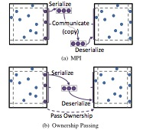
Introduction
Two Copy
One Copy
P1
P2
P3
P4
P1
P2
P3
P4
System Buffer
Zero Copy

Slide 10
Introduction
Stencil

Slide 11
Write
Original
Send
Read
Optimization
Send
Write
Read
Torsten
Shared Memory
One-Copy
One-Copy

Slide 12

Introduction
In the recent MPI-3.0 standard, process-level shared- memory interfaces are introduced.
With such interfaces, processes in a shared-memory domain (usually a node) can access each other’s memory with direct load/store instructions.
This approach offer the possibility that programmers can have true zero-copy intranode communication.

Slide 13
Outline
Introduction
Implementation
Overhead Analysis and Solutions
Communication Performance Evaluation
Conclusion and Future Work
Summary

Slide 14
Implementation
MPI-3.0 Shared Memory
Communicator Split
MPI_Comm_split_type
Memory Allocation
MPI_Win_allocate_shared
Windows Query (pointer query)
MPI_Win_shared_query
Synchronization and Data Consistency
MPI_Win_sync
MPI_Barrier

Slide 15
Implementation
Load Directly
Zero-Copy
Totally Shared Memory

Slide 17
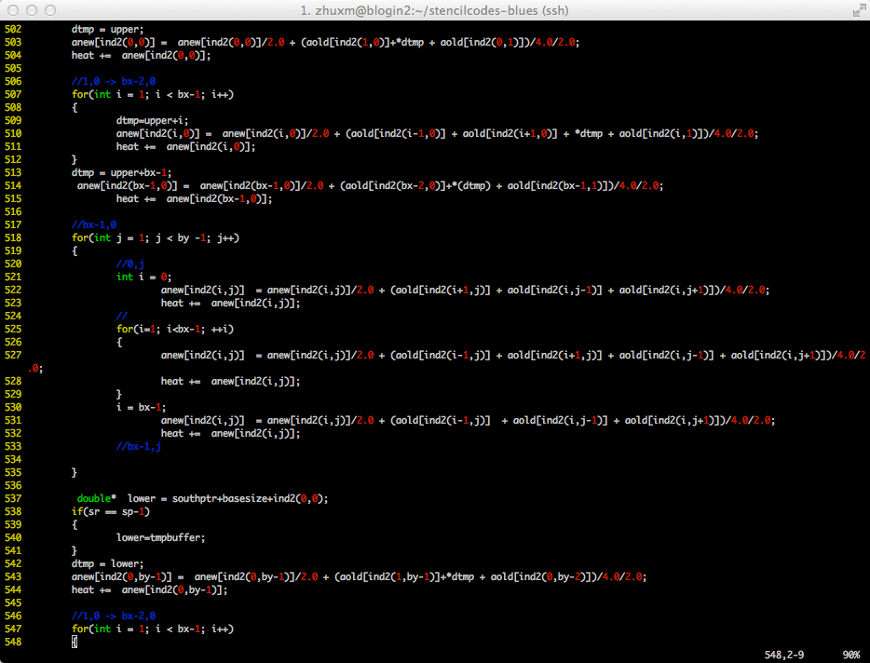
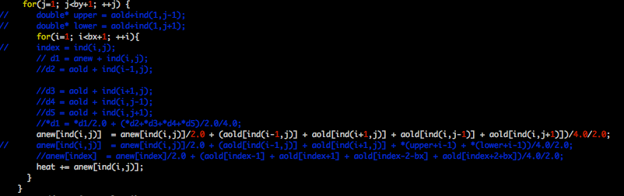
Implementation
Stencil with MPI-3.0 Shared Memory

Slide 18
Outline
Introduction
Implementation
Overhead Analysis and Solutions
Communication Performance Evaluation
Conclusion and Future Work
Summary

Slide 19
Overhead Analysis and Solutions
Motivation:
Since it improves the communication performance, we should focus on the computation to see if there is overhead
We found a performance gap between the MPI-1.0 and MPI-3.0 versions, especially when the matrix size was large.
We did a series of profilings and found three factors were contributing to the performance gap
compiler optimizations
cache misses
page faults and TLB data miss

Slide 20
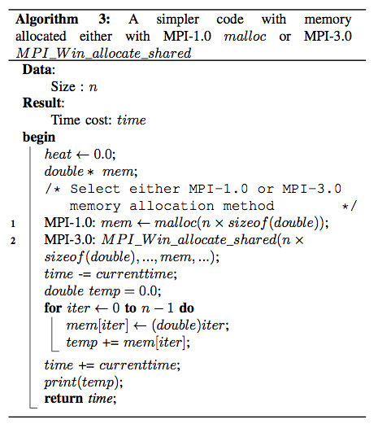
Overhead Analysis and Solutions
Methods
We abstracted the algorithm to a simpler one, which just assigns a value to each element of the memory instead of the stencil computation.
The only difference between the MPI-1.0 and MPI-3.0 implementations is the memory-allocating methods.

Slide 21
Overhead Analysis and Solutions
Compiling Optimization
We found the prototype of the malloc function in glibc has a special attribute decoration, __attribute__((__malloc__)). This is a GCC extension and is supported by both GCC and Intel compilers.
In contrast, MPI_Win_allocate_shared returns the memory allocated through the baseptr argument instead of the return value, and hence does not have this attribute.

Slide 22
Overhead Analysis and Solutions
The compiler is conservative at optimizations.
To overcome this defect, we found a simple approach is to add the restrict keyword to the pointer passed to MPI_Win_allocate_shared.
The restrict keyword conveys the compiler the same information that the pointer does not alias other valid pointers.
For the simple code, we also found another approach, that is to declare a second pointer after shared memory allocation and assign mem to mem2, which guarantees mem2 will never point to itself, and thus the compiler can optimize the for loop.

Slide 23
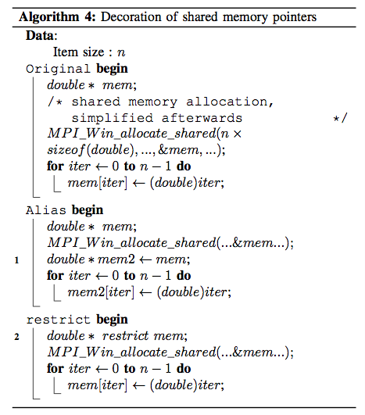
Overhead Analysis and Solutions

Slide 24
Overhead Analysis and Solutions
With the Intel icc-13.1.3 compiler on Blues, we verified the above analysis by passing -vec-report6 and -par-report to icc.
Without the restrict keyword or the alias mem2, icc reported “loop was not vectorized: existence of vector dependence”, and pointed out the reason was because of the flow and anti-dependence on the mem variable in the loop body.
With the restrict keyword or the alias mem2, the compiler reported “LOOP WAS VECTORIZED”. Vectorization has a big performance impact.

Slide 25
Overhead Analysis and Solutions
Compiling Optimization-Performance Improvement

Slide 26
Overhead Analysis and Solutions
Cache Misses
For a matrix of size m ∗ n,
the relative offsets of the left, right, up, and down neighbors of an element:
MPI-1.0: −1, 1, −(m+2), and (m+2)
MPI-3.0: −1, 1, −m, and m
Parallel data access pattern, the stride between two processes
MPI-1.0:(m + 2) × (n + 2)
MPI-3.0: m×n

Slide 27
Overhead Analysis and Solutions
Cache Misses
Since the cache miss and memory bank conflict are different with different size, we profiled different matrix sizes. In theory the performance of MPI-1.0 and MPI-3.0 should be the same as a whole.
For almost all cases, MPI-1.0 outperforms MPI-3.0
Note that for stencil problems, many data padding and re-layout techniques have been proposed.

Slide 28
Overhead Analysis and Solutions
Page Size
MPI-3.0 shared-memory functions allocate shared memory by the MPI_Win_allocate_shared function, and this is the only difference from the regular memory allocation method.
This affected the computation performance in both the simple code and the stencil code when the allocated memory size was over 2 MB.
We therefore turn our focus to page sizes, which will affect page faults and TLB data misses.

Slide 29
Virtual
Address
TLB
Physical
Memory
CPU
Physical
Address
Cached?
Yes
No
Save
Result
Translate
(MMU)
Data Read or Write
(untranslated)
A large page size can increase the coverage of the TLB
and reduce the capacity of the page table

Slide 30
Page Faults
TLB Data Miss

Slide 31
Overhead Analysis and Solutions
Based on the profiling results, especially the breakpoint at memory size 2 MB, we conjectured that the cause was the different page sizes.

Slide 32
Overhead Analysis and Solutions
Analysis:
The mmap function only creates a new range within the process’s virtual address space; it does not immediately allocate physical memory unless the MAP POPULATE flag is specified.
When the user-space program attempts a write access on an unpopulated page for the first time, the processor raises a page fault interrupt and the Linux kernel allocates a physical memory page and installs a page table entry into main memory.
A page table is used for the virtual-to-physical address translation. Loading a page table every time from main memory for the address translation is impractical, so TLB caches translation information.
Similar to other cache mechanisms, cache misses, so-called “TLB misses”, occur, which influences on memory performance. In addition to the default page size such as 4KB on x86, the memory management unit in a modern processor usually supports larger page sizes such as 2MB which can reduce the number of page faults and TLB misses, thus it improve memory performance.
In relatively newer Linux kernels with proper kernel configurations, users can use large page sizes either explicitly or transparently.

Slide 33
Overhead Analysis and Solutions
Transparent huge pages (THP)
THP is used by default if /sys/kernel/mm/transparent_hugepage/enabled is set to “always”.
It needs to increase the amount of shmem permitted per segment in /proc/sys/kernel/shmmax and increase the total amount of shared memory in terms of page number in /proc/sys/kernel/shmall.
However, THP does not work with file-backup mmap, so MPI-3.0 shared-memory functions can use only the regular page size.
Hence, the page size is different, as are the page faults and TLB misses.

Slide 34
Overhead Analysis and Solutions
Solutions
System settings:
the hugepage number in /proc/sys/vm/nr_hugepages
the group id of huge page in /proc/sys/vm/hugetlb_shm_group
These two can also be done by the sysctl command by the root, or they can be set in the configuration file /etc/sysctl.conf.
Modify the source code of MPICH 3.1.3 to use huge pages for the MPI-3.0 shared memory.

Slide 35
Overhead Analysis and Solutions
Solutions
Users can use the huge page support in the Linux kernel by using either the mmap system call or standard SYSV shared-memory system calls (shmget, shmat). Both of them are supported in MPICH and can be controlled by a configure option.
We implemented the version with shmget and found that huge pages can be used. However, the amount of space allocable with SYSV is limited. If the user tries to allocate too much space, it will fail.

Slide 36
Overhead Analysis and Solutions
Solutions
We mounted the hugetlbfs explicitly
In src/util/wrappers/mpiu_shm_wrappers.h, the path should be the mounted hugetlbfs;
In src/mpid/ch3/ channels/nemesis/src/ch3_win_fns.c, the PAGESIZE variable is changed from 4096 (4KB) to 2097152 (2 MB).
Some other accessory modifications (removal of write operation to the file and removal of munmap function) are necessary.

Slide 37
Overhead Analysis and Solutions
Effects after modification
The number of the page faults is reduced to the same level as the MPI-1.0 version when the requested memory size is over 2 MB.
TLB misses overhead is multi times, which occurs during the computing over the memory and affects the computing performance. Then we used the time consumption to evaluate it

Slide 39
Outline
Introduction
Implementation
Overhead Analysis and Solutions
Communication Performance Evaluation
Conclusion and Future Work
Summary

Slide 40
Communication Performance Evaluation
Environment
Performance Comparison
Fusion

Slide 41
Blues
MIC

Slide 42
Outline
Introduction
Implementation
Overhead Analysis and Solutions
Communication Performance Evaluation
Conclusion and Future Work
Summary

Slide 43
Conclusion and Future Work
Conclusions
MPI-3.0 shared-memory indeed helps to improve the communication performance
While it has overhead, which has been analyzed and solved
Future work
Huge page dynamic dectection in MPI implementations

Slide 44
Outline
Introduction
Implementation
Overhead Analysis and Solutions
Communication Performance Evaluation
Conclusion and Future Work
Summary

Slide 45
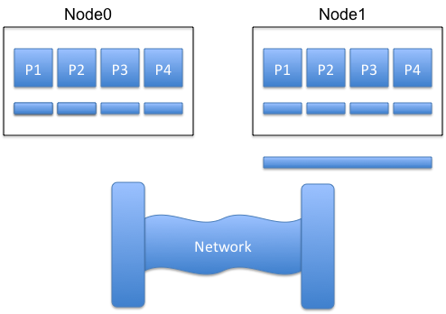
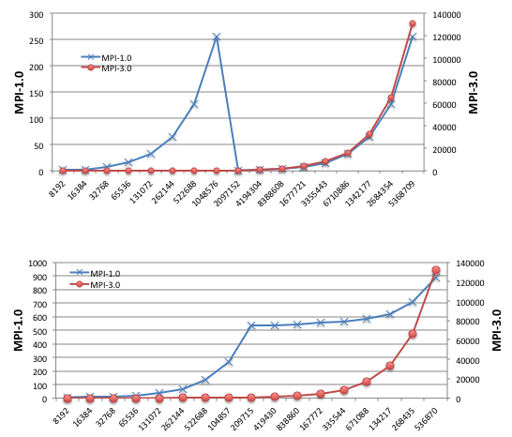
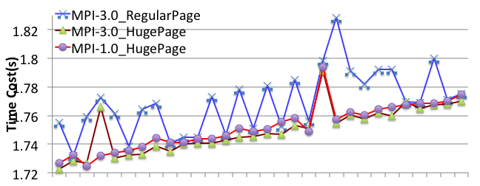
Summary

Slide 46
Outline
Introduction
Implementation
Overhead Analysis and Solutions
Communication Performance Evaluation
Conclusion and Future Work
Summary

Slide 47
Acknowledgement
Thanks to the reviewers, and Bingqiang Wang, Mian Lu
This work is partially supported by
the Promotive research fund for excellent young and middle-aged scientists of Shandong Province under Grant BS2013DX028
the State Key Program of National Natural Science of China under Grant No.61432018
the National Natural Science Foundation of China under Grant No. 61272136.
Additionally, this material was based upon work supported in part by
the U.S. Department of Energy, Office of Science, under contract DE-AC02- 06CH11357.

Slide 48

Thanks! Questions?

Slide 49
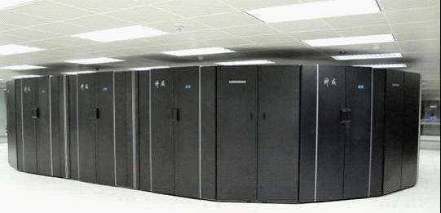
About NSCC-JN(1/3)
It is one of the 5 Peta-Flops National SuperComputer Centers in China
It has a 1P supercomputer named Sunway Blue Light with domestic CPUs

Slide 50
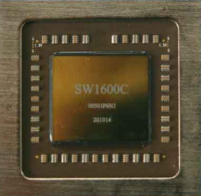
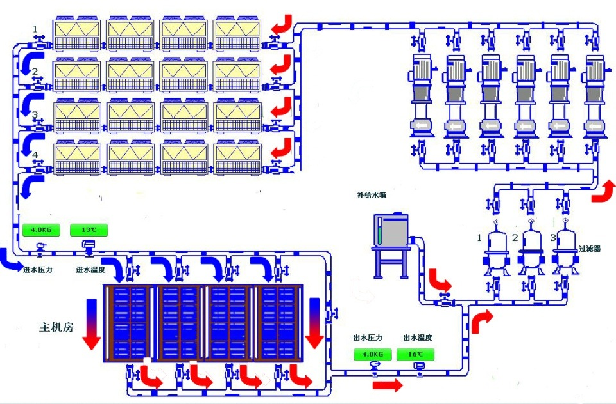
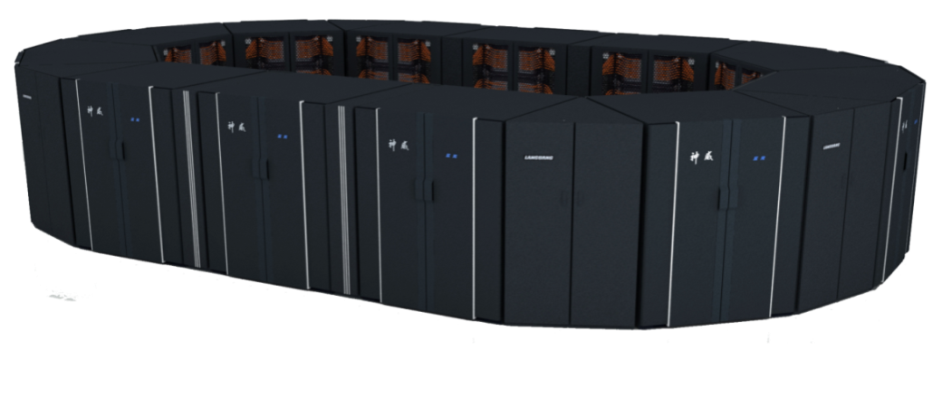
About NSCC-JN(2/3)
Several Characteristics of Sunway Blue Light
CPU is domestic
Water-cooling
High Density
8.5 computer cabinets, 2 network cabinets;60m²（650ft²）area

Slide 51
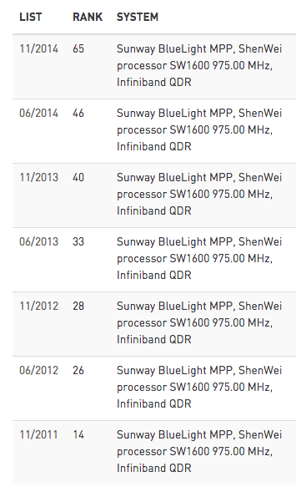
About NSCC-JN(3/3)

Slide 52
Overview
1. Use MPI-3.0 new shared memory functions instead of MPI_Send/Recv to implement intra-node communication
2. Analyze the overheads of the computation on the shared memory, and give solutions to avoid them, including compiler optimization and page size
3. Intra-node communication performance is improved

